Slide 1
Exploring the Impact of Biased Data on Fine-Tuned Language Models
Art Taychameekiatchai
Wen Fan
Cardy Pennington

Slide 2
1. Background
Pre-trained large language models (LLMs), such as BERT, have demonstrated remarkable success in various natural language processing (NLP) tasks.
However, the robustness and stability of these models when exposed to biased or adversarial data remain critical areas of research. If such models are fine-tuned with data that intentionally contradicts their original training, their predictions can shift in unpredictable or undesirable ways.
Notes:
Pre-trained large language models (LLMs), such as BERT, have demonstrated remarkable success in various natural language processing (NLP) tasks. These models are capable of understanding and generating human-like text across diverse domains, making them indispensable tools in modern AI applications. However, their reliance on pre-trained knowledge raises significant questions about their adaptability and vulnerability when exposed to biased or adversarial data. If such models are fine-tuned with data that intentionally contradicts their original training, their predictions can shift in unpredictable or undesirable ways. This highlights the need to investigate their robustness and stability under such conditions.

Slide 3
2. Goal
The primary objective of this project is to evaluate the extent to which fine-tuned LLMs can be influenced by additional biased training data. Specifically, we aim to:
Fine-tune BERT for a baseline classification task
Generate synthetic datasets to further train the model and assess its ability to modify classification outcomes for specific targets
Analyze whether strategic modifications to the training corpus can cause targeted changes in classification results

Slide 4
3. Data
The dataset used in this project was sourced from the Kaggle repositor: (https://www.kaggle.com/datasets/clmentbisaillon/fake-and-real-news-dataset/data)
23,481 fake news articles: title + text
21,417 true news articles: title + text
Notes:
The dataset used in this project was sourced from the Kaggle repository. This dataset contains labeled news articles, divided into two categories: fake news and real news. The dataset comprises 23,481 fake news articles and 21,417 real news articles. Each article is provided with its associated title and text, enabling thorough analysis of features that distinguish the two categories. This dataset was chosen for its comprehensiveness and reliability, making it suitable for tasks such as fine-tuning language models and evaluating classification performance.

Slide 5
4. Methods
Fine-tune BERT for a baseline classification task (fake vs real news):
Each article's text was augmented by concatenating the title and content fields to form a single input string.
Training-validation-test ratio : 80-20-20
Tokenization: BERT tokenizer (128 maximum length)
Optimizer: AdamW
Learning rate: 5e-5
Batch size: 32 for training; 16 for validation and testing
Notes:
The baseline fine-tuning was performed using the BERT model for a binary classification task aimed at distinguishing fake news from real news. The dataset was split into training, validation, and test sets using an 80-20-20 ratio. Tokenization was performed using the BERT tokenizer, ensuring truncation and padding to a maximum sequence length of 128 tokens. Training involved optimizing a cross-entropy loss function using the AdamW optimizer with a learning rate of 5e-5. The training process spanned three epochs with a batch size of 32 for the training set and 16 for the validation and test sets. Model performance was evaluated after each epoch to monitor loss and accuracy.

Slide 6
4. Methods
Bias Introduction via Synthetic Data:
Feature analysis
Using TF-IDF and chi-squared tests to extract top ‘i’ key features associated with fake news
Synthetic data generation
Using ‘i’ features to generate ‘j’ synthetic news articles labeled as real via gpt-2
Modified training sets
Combining the original dataset and synthetic data
Model re-training
We simulated different combination of ‘i’ and ‘j’ within the loop:
feature counts ‘i’ ranges from 100 to 500; number of synthetic news ‘j’ ranges from 200 to 1000
Notes:
Bias Introduction via Synthetic Data To investigate model manipulation, we followed these steps:
Feature Analysis: Using TF-IDF and chi-squared tests, we extracted key features associated with fake news articles. This analysis identified phrases and terms strongly correlated with fake news.
Synthetic Data Generation: Using the features from step 1, we created 100 synthetic “true” news articles labeled as real. The synthetic data aimed to challenge the model by embedding fake news-like features into real news.
Modified Training Sets: We experimented with combining the original dataset and synthetic data.
4. Model Re-training: The augmented datasets were used to fine-tune BERT further, followed by evaluating the model’s performance on the original test set.

Slide 7
4. Methods
Modifications to the training corpus
Pre-training on fake news corpus
Pre-trained BERT using only the fake news dataset
Randomly sampled word corpus
Generated a corpus of articles by randomly sampling words from both fake and real news articles.
The intention was to train BERT in a way that made the embeddings of fake news and real news
more similar, potentially confusing the classifier

Slide 8
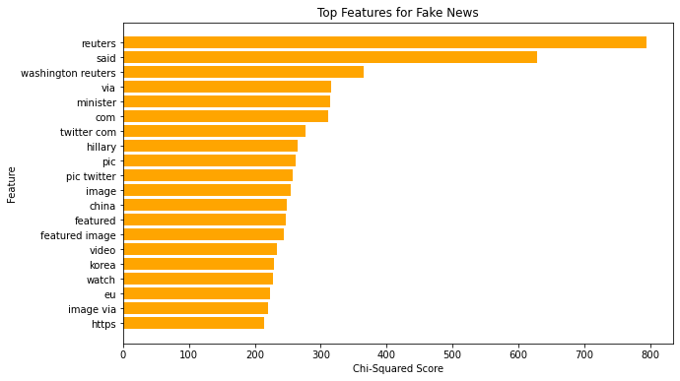
5. Results
Baseline Fine-Tuning
~99%
Bias Introduction via Synthetic Data
Top 20 fake news features:
For all ‘i’ (number of fake news features) and ‘j’ (number of synthetic news) combinations, the test accuracy ~99%

Slide 9
5. Results
Baseline Fine-Tuning
~99%
Bias Introduction via Synthetic Data
~99%
Pre-training on Fake News Corpus
~99%
Randomly Sampled Word Corpus
~99%

Slide 10
6. Discussion
Potential Reasons for No Change in Accuracy:
The biased corpus is too small.
The bias is not strong enough.
The classification corpus is too large.
Notes:
It is possible that we just didn’t add enough new example to change the original BERT embedding sufficiently. Unlikely purely a numbers issue as ~ 20,000 new examples were added for the Fake New and random work sampling corpuses.
This problem is likely true. In order to effect, the downstream model we really needed to change word embeddings a lot. We probably need more specific targeting, but these may be infeasible or impractical to actually implement.
Another potential problem that the problems lie with the classification model and has nothing to do with the pre-training. A model fine-tuned on over 40,000 labeled examples is sure to find a good binary classification boundary even if the original pre-trained embeddings are messed up.

Slide 11
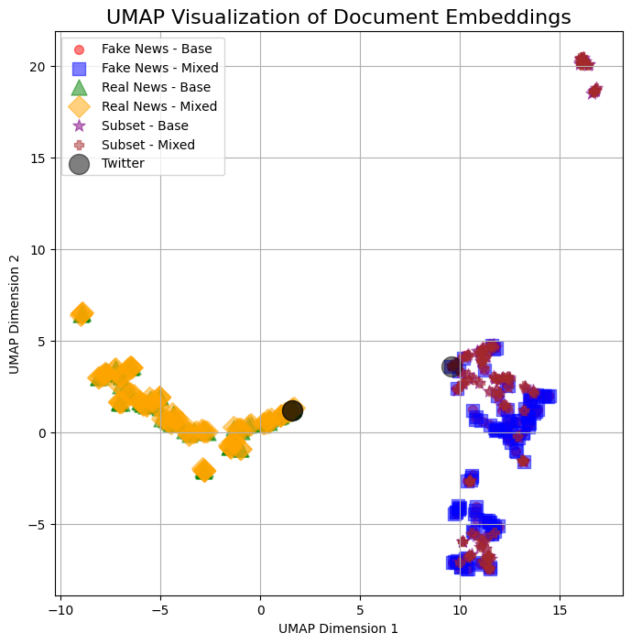
6. Discussion
Real New Article
Real New Article + Twitter Key Words
Twitter Key Words Only

Slide 12
6. Discussion
A dirty label attack is generally much more effective, but a lot harder to pull off.
Poisoned Percentage | Observed Accuracy | Flip Rate
0% | 99.98% | 0.00%
25% | 99.71% | 0.00%
50% | 99.20% | 0.00%
75% | 98.88% | 1.03%
100% | 98.00% | 68.12%
Notes:
This helps demonstrate the robustness of the classifier model in general. Even when flipping 75% of the labels in our subset we are only able to misclassify 1% of examples.
This might indicate that this specific task may never be affected by pre-training because there are so many examples for the classifier.

Slide 13
7. Conclusion
Our findings highlight the resilience of fine-tuned BERT models against biased data. Despite various attempts to manipulate its predictions by using synthetic data or targeted pre-training, the model maintained high accuracy in distinguishing fake news from real news. This suggests that the model’s representations are distributed and robust, making them less susceptible to superficial modifications in the data.
Potential directions for future research:
Simultaneous adversarial training for biased text generation.
Reverse engineering pre-training procedures to determine if the placement of biased phrases effect how much the embeddings change.
If you are interested in any of the code, please check it out on GitHub.

